Slide 1
Getting into Medical School The dreaded UKCAT (and Medsim)
Tom Smyth
University of Glasgow

Slide 2
What is the UKCAT?
An admissions test used by a variety of UK medical and dental schools
Aims to test one’s mental abilities, attitude and professional behaviours required for doctors to be successful in their careers
It is used alongside your personal statement, exam results and interviews

Slide 3
What is the format?
The UKCAT test you in these subjects:
Verbal reasoning
Quantitative reasoning
Decision Making
Abstract reasoning
Situational Judgement

Slide 4
Verbal Reasoning

Slide 5
Quantitative reasoning

Slide 6
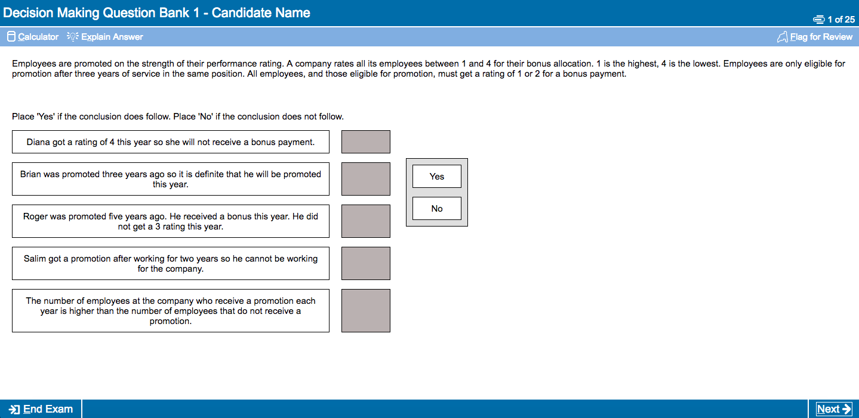
Decision Making

Slide 7
Abstract Reasoning

Slide 8
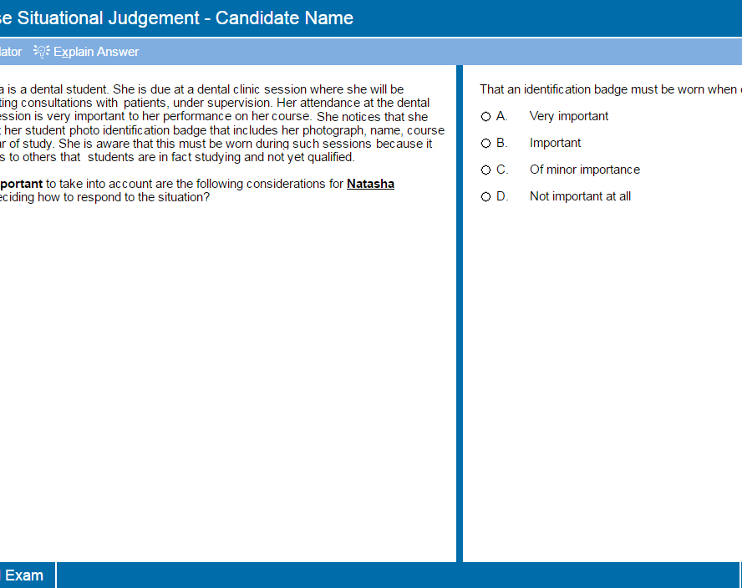
Situational Judgment

Slide 9
Know your timings!

Slide 10
When Do I sit it?
Registrations Opens: 2 May
Testing Begins: 3 July
Registration Closes: 19 September
Booking closes: 2 October
Last Testing day: 3 October
UCAS application deadline: 15 October
These dates are applicable to applications in 2017/2018

Slide 11
The Costs
From 3 July to 31 August: £65
From 1st September to 3 October: £85
Bursary Schemes are available
If you get extra time in school exams look into the UKCATSEN

Slide 12
What Happens on the Day?
Sit test at the same place you would do your driving theory test
Need to bring Photo ID and Email of confirmation of test
You are provided with an on screen calculator and a note board and pen for workings

Slide 13
My experience with the UKCAT

Slide 14
Key points
Exam technique is key
Have a mindset that its ok to skip questions, concentrate on what you are good at
Practice, practice, practice
Find resources that YOU find useful (courses, books, online, apps…)

Slide 15
How each university uses the UKCAT

Slide 16
For 2016 entry
Aberdeen: lowest total score for an applicant invited to interview was 2180 and the highest 3350
Glasgow: lowest total score considered for interview 2680
St Andrews: Will interview their top 400 candidates, and use the SJT
Edinburgh: No minimum cut-off
Dundee: No minimum cut-off

Slide 17
Average Scores over past Years

Slide 18
https://www.ukcat.ac.uk/ukcat-test/

Slide 19
MedSIM
A series of workshops: Keyhole surgery, Basics of taking bloods, Trauma and triage, BP, X-rays, USS, ECG, Practical anatomy
When: 15/16th July
Hosted at the University of Nottingham
Basic price: £295 (plus extras)
No real impact on applications
Get to stay at university halls

Slide 20
https://medlink-uk.net/

Slide 21
Any Questions?

