Slide 1

Welcome
Professor Mike Griffin OBE
President, the Royal College of Surgeons of Edinburgh

Slide 2

Welcome

Slide 3
Welcome
#letsremoveit

Slide 4
Welcome
Dr Jo Mountfield
Vice President Workforce, the Royal College of Obstetricians & Gynaecologists

Slide 5
Welcome
Dr Alison Wright
Consultant Obstetrician & Gynaecologist, the Royal Free Hospital, London

Slide 6
Session 1
Understanding the Complexity of Bullying
Dr Henrietta Hughes OBE
National Guardian for the NHS

Slide 7
Tackling Undermining and Bullying in the NHS
13 February 2020
Dr Henrietta Hughes OBE FRCGP
National Guardian for the NHS
@NatGuardianFTSU

Slide 8
What is speaking up?
Speaking up is about encouraging staff to raise concerns
Speaking up happens when leaders foster a positive speaking up culture

Slide 9
Get the culture right first
£
Safety
Culture
Notes:
Pyramid with culture at the bottom, then safety then finance (or a £ sign) over 3 slides then turned upside down

Slide 10
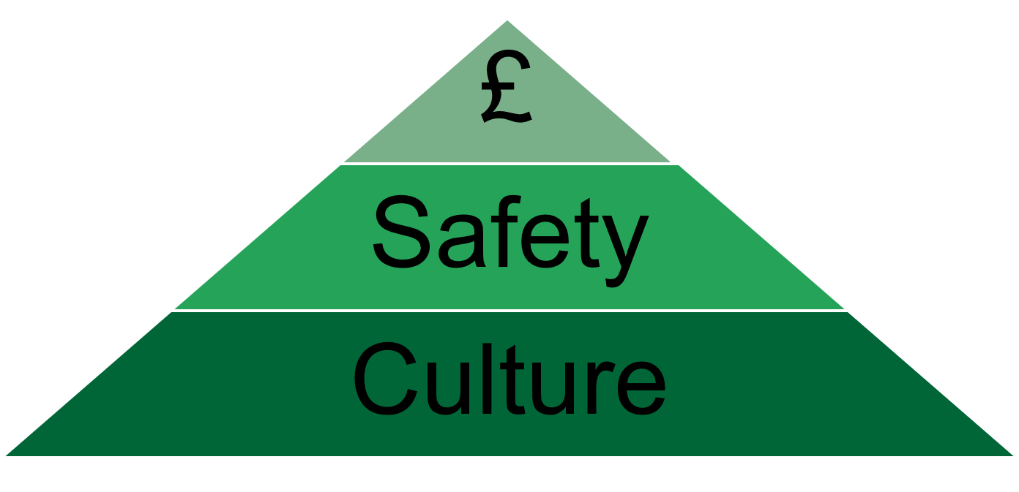
Get the culture right first
Notes:
Pyramid with culture at the bottom, then safety then finance (or a £ sign) over 3 slides then turned upside down

Slide 11
Rhetoric vs reality

Slide 12




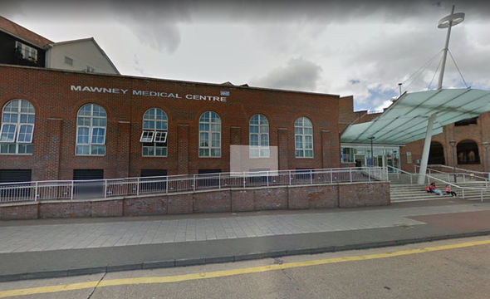

Why do we need this?

Slide 13

Freedom to Speak Up
>500 guardians with others in a supporting role in England
Perceptions and performance
Freedom to Speak Up Index
Speaking up data

Slide 14
Freedom to Speak Up Guardian Survey 2019

Slide 15
Freedom to Speak Up Guardian Survey 2019

Slide 16
Freedom to Speak Up Guardian Survey 2019

Slide 17
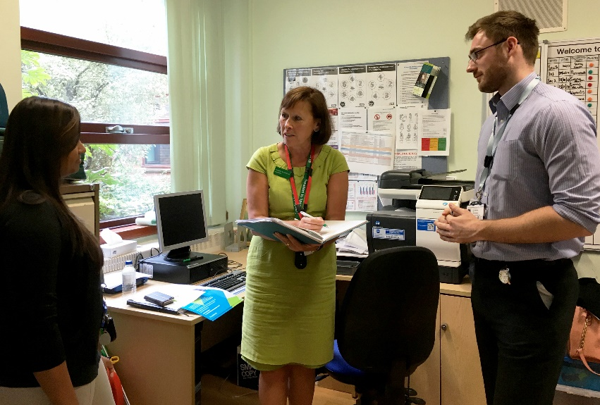
Freedom to Speak Up Index 2019
Four questions from the annual NHS staff survey
Knowledgeable, encouraged, secure
Aggregated score
Track over time
Learn from the best
Case studies

Slide 18
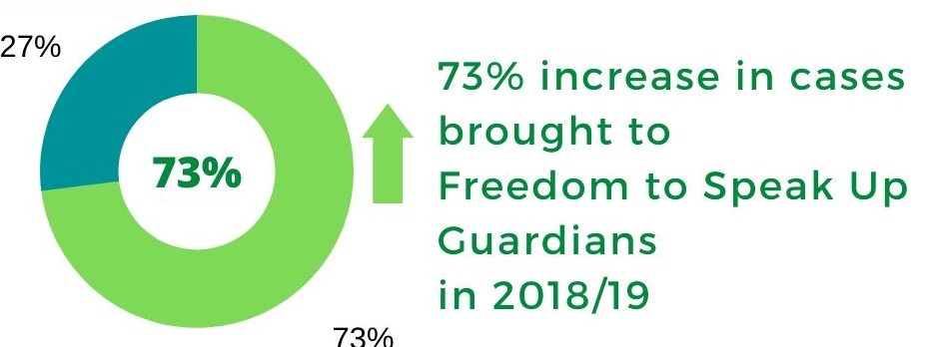
Speaking up data
7,087
2017/18
12,244
2018/19
Based on data returns from NHS trusts and foundation trusts April ’17 – March ‘19

Slide 19
Speaking up data
12,244
2018/19
Based on data returns from NHS trusts and foundation trusts April ’18 – March ‘19

Slide 20
100 Voices
I was told that ‘there was not enough evidence’ to raise a formal complaint,”
I spoke to my line manager first, when I saw that no change was made, I escalated this to my line manager’s manager. No changes were made.
I tried numerous times to raise concerns within my department.
I had sat in the office for several weeks worrying if I should speak to a colleague, a manager or a friend outside work.

Slide 21
100 Voices
Since I have had the support of the Freedom to Speak Up Guardian I have had so much more success at being taken seriously.
I have learnt that speaking up about issues that I have experienced, seen or heard is worthwhile. I am now no longer afraid to speak up.
An email to the guardian changed a lot, making the trust a better place to work and providing safer care for our patients.
If it hadn’t been for the Freedom to Speak Up Guardian, I do not know where I’d be today. She stood by me every step of the way. I cried, I laughed and even at times, got angry and she did not once pass judgement.

Slide 22
National Guardian’s Office
Champion people who speak up through the network of Freedom to Speak up Guardians
Training, guidance and support to guardians
Case reviews
Information and insights to organisations
Support and challenge to the system
Training for workers, managers and leaders planned

Slide 23
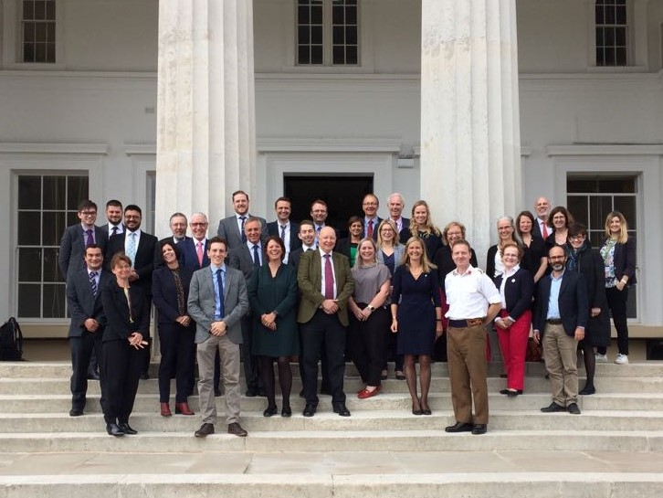
Pan sector network
Aviation, banking, finance, military, health, retail, oil and gas, sport
Learn and share
Challenges and best practice

Slide 24
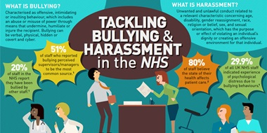
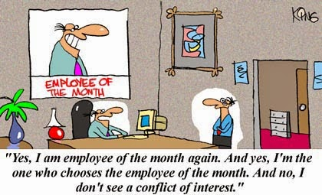
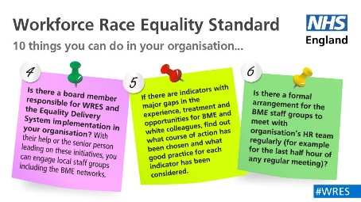
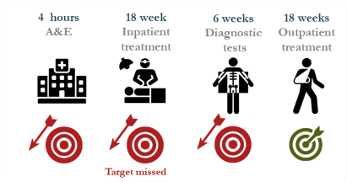
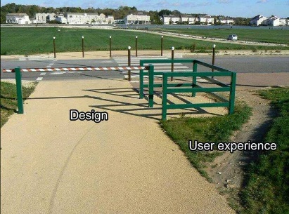

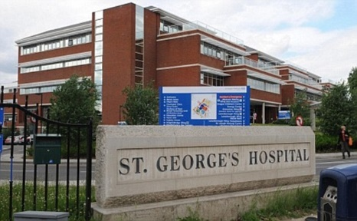

What is wrong with your culture?
Bullying behaviours
Conflicts of interest
Inequality
Focus on targets
Competition
Workarounds
Entrenched views
Rivalry

Slide 25


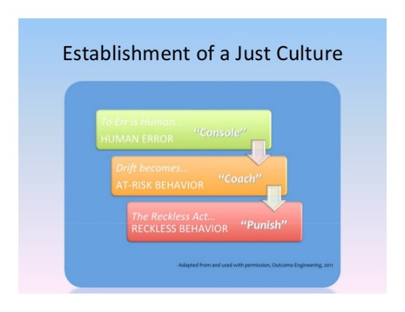




What do we want the culture to look like?

Slide 26
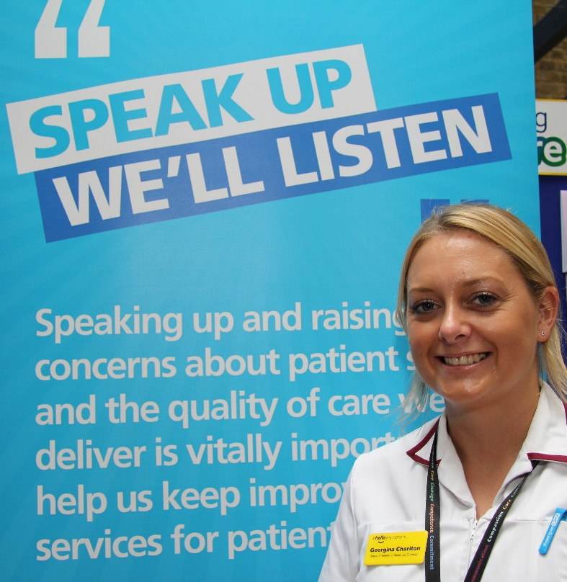
Our next steps
Make speaking up business as usual
Phase Two of case reviews
Primary care Vanguards
100 Voices campaign
Training
Independent annual report laid before Parliament

Slide 27
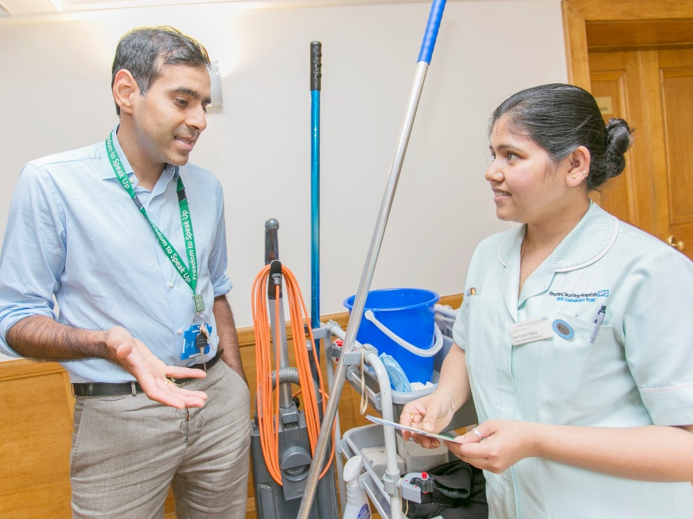

Your next steps?
Appoint Freedom to Speak up Guardians
Speak up yourself
Listen with fascination
Make improvements

Slide 28
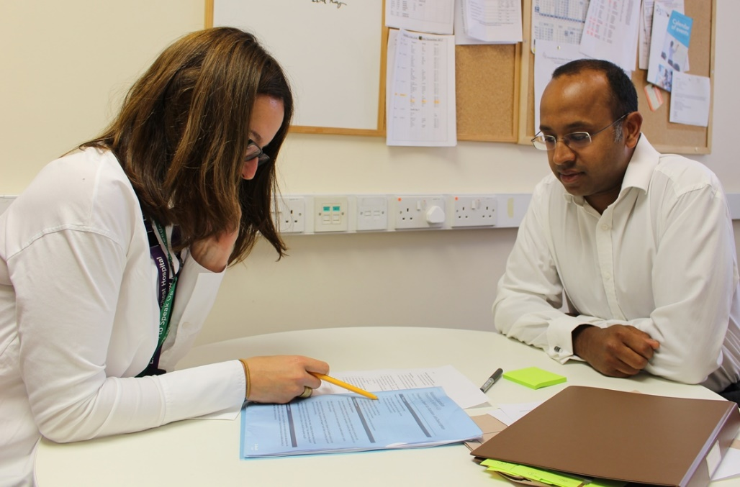
Thank you
@NatGuardianFTSU
#FTSU
www.nationalguardian.org.uk

Slide 29
Session 2
Bullying or Banter – What’s The Difference?
Sally Brett
British Medical Association

Slide 30
Bullying or banter?
Sally Brett
Head of Equality, Inclusion Culture

Slide 31
Inquiry into racial harassment in universities
All too often, offensive comments were justified by perpetrators as ‘jokes’ or ‘banter’.
…it was dismissed as ‘banter’ without understanding the effect of the behaviour
White staff treated racial slurs as ‘banter’
“Everyone I reported this to was white and from every single person I was told I was overreacting and that I should take it as banter”
Equality and Human Rights Commission (2019)
Notes:
These findings from a recent inquiry into racial harassment in British universities highlight how ‘banter’ is still one of the most common defences to allegations of bullying or harassment.
It was something that Black and Minority Ethnic medical students brought up in a roundtable we held last year to discuss racial harassment and racism within medical schools too. Medical students described how difficult it was to challenge potentially harmful behaviour or comments because they felt there was a lack of clarity about what was acceptable, particularly when peers and staff were so quick to say ‘it was just a joke’ and to dismiss things as ‘banter’.

Slide 32
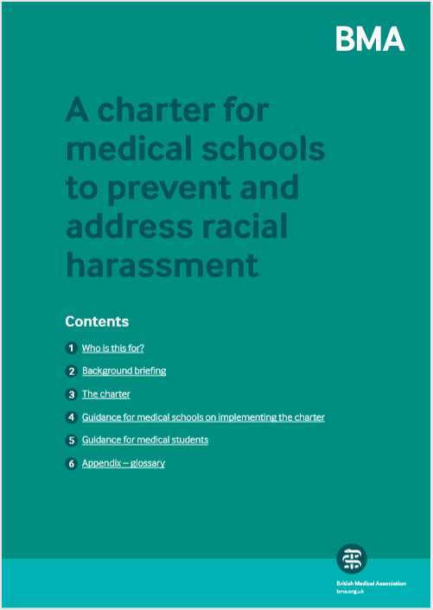
Launched today…
Notes:
That was all just a segue into me doing a plug for the BMA’s charter and guidance on preventing and addressing racial harassment in medical schools, launched today. Speak to me in the break if anyone wants to find out more!

Slide 33
Just a bit of fun or crossing the line?
73% would not ban banter in the workplace (only 5% would)
20% of women lost workplace confidence because of banter and 10% of men
Two-thirds said health, mental health and sexual orientation were out of bounds
Over 2/3rds of men and 56% of women use banter to get to know colleagues
Age was the most common topic of banter (71%) followed by gender (52%)
62% said religion and ethnicity were out of bounds
Institute of Leadership and Management (2018)
Notes:
So is banter all bad? Should it be banned in the workplace? – I actually got a question wrong in some online diversity training a couple of years ago. I ticked the box that said banter was sometimes acceptable in the workplace but the correct answer, according to that particular training module was that it ‘never’ was.
It would make for a very short talk if I just said all banter should be banned. So we will assume that banter, which is usually defined as the playful exchange of humorous or teasing remarks, can have benefits for the workplace, provided people know when it is appropriate and what kind of remarks are likely to cross the line and in which situations.
Members of the Institute of Leadership and Management agree that it’s not all bad too. They found that three-quarters of managers and leaders would not ban banter at work – and only 5% said they would. The majority saw benefits in banter like improving morale and getting to know colleagues better.
There were some interesting gender differences in responses too. A majority of men and women said they used banter to get to know colleagues, but men used it a bit more than women. And women were twice as likely as men to say they had lost confidence as a result of workplace banter – a fifth of women experienced this negative impact compared to a tenth of men.
It is good to see that a majority of managers and leaders recognise that banter about health, mental health, sexual orientation and ethnicity is out of bounds in the workplace (though a bit worrying to me that those figures aren’t higher). Interesting that it seems the same doesn’t seem to apply to age and gender, as they were said to be the most common topics of banter at work.

Slide 34

Where do you draw the line?
Notes:
So where do you draw the line between bullying and banter?

Slide 35
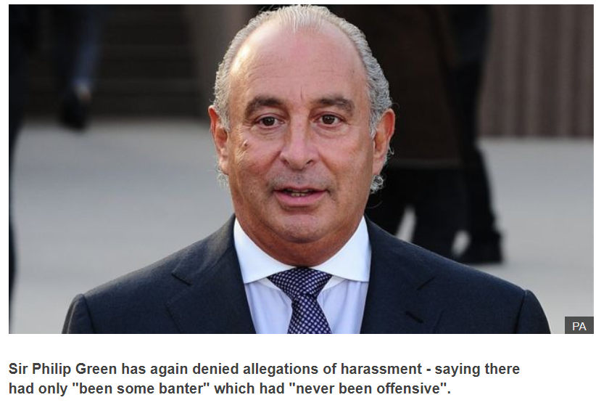
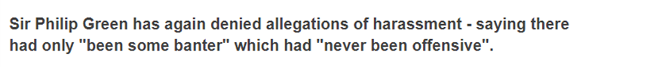
Perpetrators don’t get to choose…
Notes:
The first key point – sorry Philip Green - is perpetrators don’t get to choose where that line is drawn.

Slide 36
Definition of harassment
It is conduct that:
has the purpose or effect of violating someone’s dignity or creating an intimidating, hostile, degrading, humiliating or offensive environment for them
is unwanted
is related to a protected characteristic (age, disability, gender reassignment, race, religion or belief, sex, sexual orientation) or of a sexual nature
Notes:
I’m actually going to talk mainly about harassment rather than bullying in the rest of this presentation. This is because we helpfully have a legal definition of harassment in equality legislation. So we can learn from employment tribunals who’ve considered where the line should be drawn and whether it’s been crossed. And while we don’t have a legal definition of bullying, if you look at the definition of workplace bullying from ACAS, it is quite similar to this – the main difference being that it doesn’t have to be related to a protected characteristic.
So the legal definition of harassment says it is conduct that has the purpose or the effect of violating someone’s dignity or creating an intimidating, hostile, degrading or offensive environment for them - you don’t have to prove both intent and effect. Similarly, the Acas definition of workplace bullying makes no mention of the intent behind the behaviour.
To add further clarity, new technical guidance on workplace harassment from the EHRC, which is soon likely to become statutory guidance in Britain, states: ‘Conduct that has one of these effects can be harassment even if the effect was not intended’.

Slide 37
Example 1 – a shared joke with no intent
Male workers download pornographic images on to their computers in an office where a woman worked. They merely considered the downloading of images as ‘having a laugh’. The men don’t show the images to the woman but she knows they have been downloaded.
It is irrelevant that the male workers did not intend to upset the woman. They have had the effect of creating a degrading, hostile and humiliating environment for her.
Notes:
This is an example given in the EHRC’s new technical guidance to illustrate the point and it is based on a decided tribunal case.
A group of men thought they were just having a laugh when downloading pornographic images while at work. They didn’t show them to the woman they shared an office with and had no intention of offending her. But she knew they had been downloaded and the images had the effect of creating a degrading, hostile and humiliating environment for her. This was not a joke for her – she had been sexually harassed.

Slide 38
Definition of harassment
It is conduct that:
has the purpose or effect of violating someone’s dignity or creating an intimidating, hostile, degrading, humiliating or offensive environment for them
is unwanted
is related to a protected characteristic (age, disability, gender reassignment, race, religion or belief, sex, sexual orientation) or of a sexual nature
Notes:
The next key part of the definition of harassment is that the conduct is unwanted.
This might seem an obvious point. And it is probably the key defining point between bullying or banter – banter should be a fun, enjoyable and shared experience or two-way exchange – whereas bullying is not welcome and is one-sided and usually an abuse of power.
But there is a bit more to think about when determining whether conduct is ‘unwanted’. The EHRC’s new technical guidance adds a couple of really important points too:
First, unwanted means ‘unwanted by the worker and should be considered from the worker’s subjective point of view’.
Second, ‘It is not necessary for the worker to say that they object to the conduct for it to be unwanted’.

Slide 39
Barriers to speaking up
Power and authority
The need to belong and be accepted by others
Being a woman or in a minority in the workplace
Feeling that you are at fault e.g. ‘I need to toughen up’, be more resilient or less sensitive
“…’banter’ is a loose expression, covering what otherwise might be abusive behaviour.... It can easily transform into bullying when a subordinate employee effectively has no alternative but to accept/participate in this conduct.” Employment Tribunal, Minto v Wernick Event Hire (2011)
Notes:
We know there are all sorts of barriers to speaking up and to letting people know when behaviour is unwanted – particularly in a very hierarchical profession or working environment – and to people who have authority over you.
There is a strong innate human need to belong, to form social relationships, and be accepted by others in a group - challenging existing ways of behaving in a group can be very hard to do and involves all sorts of social risks for an individual.
It may be especially difficult if you are in a minority or you are a woman in a workplace or profession that is or has traditionally been male-dominated. Interestingly, in the Institute of Leadership and Management Survey, three-quarters of men said they would be comfortable to challenge workplace banter that they thought had crossed the line but only 55% of women would – even though they were the ones more likely to experience it as unwanted conduct. We also found in a BMA survey that BAME doctors and medical students were less confident in challenging bullying or harassing behaviour than white medical students.
There may also be internal barriers to speaking up – like a lack of confidence in our judgement and perhaps a feeling that you are at fault somehow and need to change your behaviour or attitude. A feeling that you just need to toughen up, become less sensitive, become more like others at work who it doesn’t seem to bother.
If we understand that these barriers to speaking up exist. We understand that banter can still be bullying or harassment even if no-one has complained about it and told you it is unwelcome.

Slide 40
Definition of harassment
It is conduct that:
has the purpose or effect of violating someone’s dignity or creating an intimidating, hostile, degrading, humiliating or offensive environment for them
is unwanted
is related to a protected characteristic (age, disability, gender reassignment, race, religion or belief, sex, sexual orientation) or of a sexual nature
Notes:
The next key point – and this is specific to the definition of harassment – is that it has to be related to one of the protected characteristics covered by equality legislation or be of a sexual nature in the case of sexual harassment.
I’ve highlighted the words ‘related to a…’ because that wording allows for a broader range of situations than you might at first imagine to be classed as harassment. In particular, it means it is not necessary to show that the conduct is because of or connected with a protected characteristic that you have.
And I think this also has relevance when thinking about the bullying or banter situations too. It is not just the direct targets or recipients of behaviour that could be affected by it.

Slide 41
Example 2 – wider impact of banter
A black worker was repeatedly called by a racialised nickname by his manager. The manager said the worker didn’t have problem with it and would have told her if he did. The worker didn’t. However, another worker who had witnessed it did complain to tribunal that they had been harassed by overhearing the comments.
The complaint was upheld. The language had created an offensive environment for the other worker.
Notes:
This example is based on a tribunal case where a black delivery driver was repeatedly called ‘black Brian’ and racist jokes and comments were made towards him too. His manager said he didn’t have a problem with it. They had a good working relationship and the manager said he would have told her if he was offended. And he didn’t complain. But another worker who regularly overheard the same manager’s banter did.
That complaint was upheld by the tribunal. The language had created an offensive environment for the other worker. There had been racial harassment and this was regardless of whether the person targeted by it had been offended.
In this particular case, the other worker was also black. However, it isn’t necessary for any witnesses offended or humiliated by comments to also have the protected characteristic that they relate to. In fact, guidance from NI Equality Commission, when explaining the wide reach of the ‘related to a protected characteristic’ formulation includes an example of a man complaining of sexist harassment having overheard a female manager calling another female worker a ‘floozy’.

Slide 42
Factors that must be considered when assessing the effect of conduct
In deciding whether conduct has the effect of violating someone’s dignity or creating an intimidating, hostile, degrading, humiliating or offensive environment, the following must be taken into account:
the perception of the complainant
the other circumstances of the case
whether it is reasonable for the conduct to have that effect.
Notes:
Within the statutory definition of harassment, there are three factors which it says must be considered when assessing whether unwanted conduct has had the effect of violating someone’s dignity or creating an offensive or hostile working environment for them.
I’ve already emphasised how important the perception of the complainant is. The other two factors that need to be considered are the other circumstances of the case and whether it was reasonable for the conduct to have had that effect.
EHRC guidance suggests, among the other circumstances that a tribunal should consider are:
The personal circumstances of the person experiencing the conduct (for example, their health, mental health or previous experience of harassment)
Whether the perpetrator is in a position of trust or seniority to the worker or holds any other form of power over them
The race or cultural background of those involved. For example, a term may be offensive because historically it has been used in a derogatory way in relation to a particular race, but people of other races may not generally understand it to be offensive
the environment in which the conduct takes place
And whether the complainant is hypersensitive.

Slide 43
Example 3 – irrelevant previous conduct
A worker’s manager makes comments about her breasts. The worker brings a sexual harassment claim. The employer says the worker posed topless on page 3 of a national newspaper in her past so she could not have been offended by her boss’s comments.
The tribunal would be right to find that the information is irrelevant. The worker could still be offended by her boss’s comments.
Notes:
This example is given from the EHRC guidance where it explains that sometimes employers or perpetrators try to bring in factors under ‘other circumstances’ that are not relevant.
A worker’s manager makes comments about her body. When she complains of sexual harassment, the employer tries to suggest that she could not have taken offence at those kind of comments, because she had previously posed topless on page 3 for a national newspaper. But the EHRC guidance says that the tribunal would be right to dismiss that information as irrelevant to deciding the case. The worker could still be offended and humiliated by her boss making such comments to her in the workplace.
This also reminded me of a tribunal claim brought by a worker who was out and very open about his sexuality at work. He brought a claim of sexual orientation harassment following a lot of jokes and comments about his sexuality from colleagues. The tribunal upheld the claim, making clear that whilst a person who ‘parades their particular characteristic loudly and vocally’ might expect comments about it… this is completely distinct from ‘abusive’ references from colleagues.’
So be careful about trying to suggest that someone should have been able to put up with banter and not be offended by it because of something you perceive about their character or resilience.

Slide 44

Example 4 – active participation in banter
An overweight worker who had diabetes and had strong links to the traveller community brought a claim of race and disability harassment after being called a ‘fat ginger Pikey’, ‘salad dodger’ and ‘fat Yoda’. He had used similarly offensive language to describe colleagues and the evidence suggested he was comfortable with the office environment.
BUT leaving a work environment and culture like this unchanged presents significant risks of harm to others and risks other harassment claims.
Notes:
This example comes from a tribunal case that got quite a bit of media attention last year. This is one where I have actually included the terms used, apologies if they offend anyone, but it is mainly to illustrate just how offensive the language was. But in this case the Employment Appeal Tribunal found that the worker had not been harassed.
The individual who had brought the claim had actively participated in the banter at this workplace, had used similarly offensive language about his colleagues and had generally seemed quite comfortable in that environment. The harassment case was actually brought after the worker was dismissed for other reasons.
Now it would be wrong to conclude from this case that it’s ok to routinely use these phrases at work and it was quite troubling to see headlines about this case like the one on the slide. That is not the message to take away. Instead, employers need to understand that in a workplace culture where terms like these are thrown about so often that others are likely to be harmed and it’s probably only a matter of time before they face other harassment complaints.
It is also worth bearing in mind that, as an individual, if you actively join in and dish out offensive banter like this to others, you may undermine your ability to complain when similar treatment is targeted at you.
Having said that, there was a similar case a few years back, in which a person actively engaged in all sorts of offensive and homophobic banter with colleagues – even though he wasn’t gay and his colleagues knew he wasn’t. The tribunal actually described it as ‘a truly horrid place to work’. But despite the complainant’s active participation in a lot of the offensive and homophobic banter, it nevertheless held that a ‘tipping point’ could still be reached for that person and a line crossed if one particular incident went too far. In that case it was potentially when his colleagues published an article in the in-house company newsletter, which his family saw, that referred to him in homophobic terms.

Slide 45
Example 5 – working environment and context
In a busy newsroom with a deadline approaching for an article about the Pope, the news editor shouts across the office ‘can anyone tell me what’s happening to the f***ing Pope?’ A Roman Catholic sub-editor takes offence and complains. He is not happy with how the complaint is dealt with. He later complains to an employment tribunal of religion or belief harassment.
In the context in which the remark was made, it was not reasonable to take offence at it.
Notes:
This is another example based on a case which received some media attention. In this case it was held that it was not reasonable for a Catholic sub-editor to have taken offence at a comment about the Pope. It was a very busy newsroom with a deadline approaching for an article about the Pope and the news editor shouted across the whole office ‘can anyone tell me what’s happening to the [expletive] Pope?’ The Employment Appeal Tribunal said it was evidently merely an expression of bad temper and not intended to express hostility to the Pope or Catholicism.

Slide 46
Guidance on borderline cases
“Dignity is not necessarily violated by things said or done which are trivial or transitory, particularly if it should have been clear that any offence was unintended. While it is very important that employers and Tribunals are sensitive to the hurt that can be caused,… it is also important not to encourage a culture of hypersensitivity or the imposition of legal liability in respect of every unfortunate phrase.” EAT, Dhaliwal v Richmond Pharmacology (2008)
Note, however, in Dhaliwal a single throwaway comment from a manager about seeing a colleague again ‘unless she was married off in India’ was racial harassment as likely to be shaped by stereotypical beliefs about Indian women
Notes:
In deciding that case the EAT referred to guidance from an earlier case, which warned of too easily accepting that someone’s dignity had been violated by trivial or transitory comments or conduct, especially if offence was unintended. The EAT said: ‘While it is very important that employers and Tribunals are sensitive to the hurt that can be caused,… it is also important not to encourage a culture of hypersensitivity or the imposition of legal liability in respect of every unfortunate phrase’
That is important guidance. But just a bit of caution against relying on it too heavily to excuse all sorts of comments made in haste. The guidance was given in a case where the EAT upheld a complaint of racial harassment against a manager who had said to a colleague of Indian origin who was leaving that their paths might cross again ‘unless she was married off in India’. It did say it was a borderline case but it felt that it could be concluded that it was reasonable for the comment to cause offence to the woman. Although it hadn’t been intended to cause harm, the comment was nevertheless shaped by stereotypical beliefs about Indian women.

Slide 47
Vicarious liability of employer for staff conduct
Anything done by a person in the course of employment must be treated as also done by the employer.
It does not matter whether that thing is done with the employer's knowledge or approval.
It is a defence to show that the employer took all reasonable steps to prevent the harassment.
Notes:
A final comment on the liability of employers for harassment. Mainly to emphasise that employers are liable for any harassment done by a person ‘in the course of employment’, even if they didn’t have knowledge of it or approve of it, unless they took all reasonable steps to prevent it from happening i.e. there was nothing more the employer could have reasonably done to prevent such conduct by their staff.
‘In the course of employment’ doesn’t just mean conduct at work, during work hours. It can also include: working off-site, attending training or conferences, a leaving party organised by work or social gatherings immediately after work. The EHRC has also urged employers to make clear in their bullying and harassment policies that staff may face disciplinary action if they harass a colleague on social media too.

Slide 48
Conclusions
If you are in a position of power or trust be very careful about how you use banter and how it might be received by others
Consider the impact of banter on those who overhear it – it may be a fun, two-way exchange for you but others may be harmed
Remember the barriers to speaking up – people won’t always tell you when remarks or jokes are unwanted
Empower people to speak up about unwelcome banter – apologise, listen and try to understand their experience don’t be dismissive
Don’t rely on someone’s previous participation in banter to excuse it – a tipping point could be reached and a line crossed for them
Remember that social events linked to work and social media posts can also be ‘in the course of employment’ – there is still a line to be drawn

Slide 49
Living our values
Our behaviour principles:
Be professional
Be accountable
Be kind
Be representative
Respect others

Slide 50
Session 3
Professional Behaviours & Patient Safety
Dan Wynn
General Medical Council

Slide 51
Session 4
Civility Saves Lives
Dr Chris Turner

Slide 52

When we permit rudeness our patients die unnecessarily
@civilitysaves

Slide 54


Notes:
Theatre was tense. List 2 became 3
Story- ordinary Tuesday, theatre, extra case. Protest but decide unfair on the patient. 1st case, consultant felt to be hostile, team stressed, crying scrub nurse (replaced). Consultant didn’t notice. Case finished, Scrub back for 3rd case. Registrar in theatre assisting. At end swab count done – correct. Multiple returns before large swab found in abdomen.
And we punished the scrub nurse. And we missed the point.
“just get on with it”
Chest drain, agony, denied morphine “must be a morphine seeker”

Slide 55
Notes:
HC Team business, com+com environ.
10yrs Ix ?understand. 10yrs ago-asked, process
With time hopefully wiser. Didn’t respect complexity.
So now, still process imp, but something else more. People and behaviour.

Slide 56

Notes:
People, and I think the evidence bears this out

Slide 57
Notes:
Not just about avoiding error- this is abut creating the best possible environment to create excellence

Slide 58
Teams

Slide 59
Notes:
We’ve already said it is complicated- a moment on teams

Slide 60
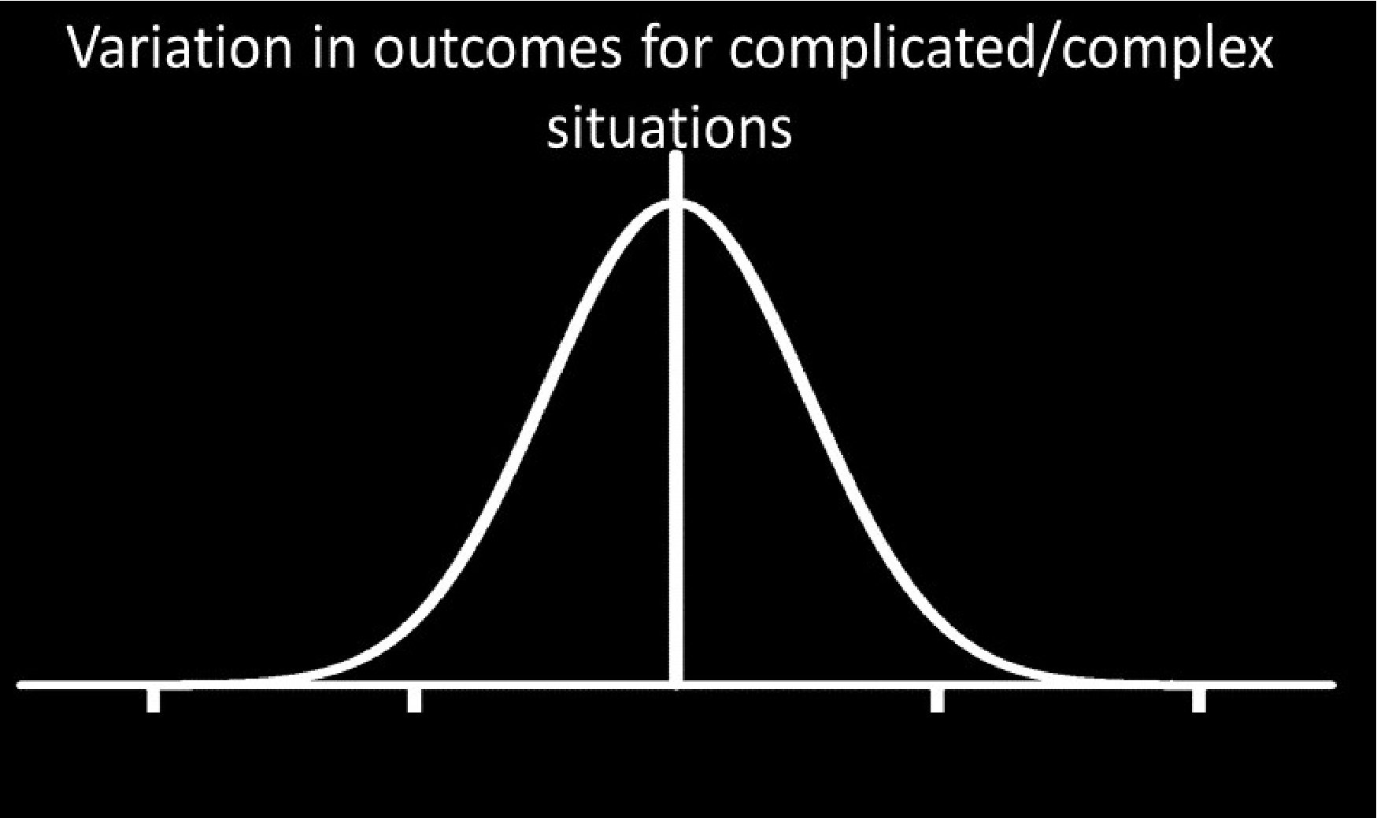
Variation in outcomes for complicated/complex situations
Catastrophic outcome
Amazing outcome
Notes:
Riskin and Erez
http://pediatrics.aappublications.org/content/136/3/487
https://www.ncbi.nlm.nih.gov/pubmed/28073958
5 conditions >70%- real team, compelling direction, enabling structure, supportive context, and competent coaching
Support- why we work better as a team when we support each other in the fight- but this does not mean that the patient gets the best treatment

Slide 62
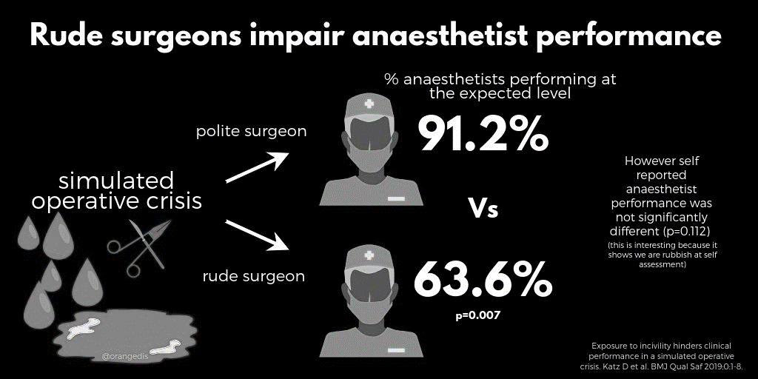
91.2%
63.6%
p of 0.007

Slide 63
How we behave towards each other is the single greatest factor in how well competent teams perform.

Slide 65
Incivility
Notes:
New science
1996-2000 (23) 2011-2015 (1700)
We talk about incivility as rudeness, or disrespect. The key is that it’s all in the eyes of the beholder
The elephant in the room. Both the cause of incidents and prevents us getting to the cause
Riskin and Erez
Shouting and learning- large emotional response, little intellectual one. Different pathways. One shoves the other out.
If you think healthcare staff need to be aroused you are hugely likely to be just plain wrong.

Slide 66
Have you seen rudeness at work?
Notes:
Maybe to you, maybe to someone near you, maybe it was by you.

Slide 67

How did it feel?
Notes:
Anger, resentment, stressed, unable to think? Ashamed? Belittled, ashamed, humiliated. The horrible power of shame.
So incivility makes us sad. So what?
Like a child.
“maybe I’m just too sensitive”
Did anyone feel less motivated? Humiliated?
A kind of lonely feeling

Slide 68

Notes:
turns out it’s not just you who was affected…
Bandwidth
bandwidth

Slide 69


Impact on the recipient
61% reduction in cognitive ability
Notes:
Also, reduced hand-eye co-ordination (important for surgeons)
5x more likely to miss the gorilla. Nurses 50% more likely to miss a calculation error.
https://thepsychologist.bps.org.uk/volume-24/edition-7/how-rudeness-takes-its-toll

Slide 70

Impact on staff onlookers
20% decrease in performance.
50% reduction in willingness to help others.
Notes:
When all around you heads go down…they are not concentrating on the work- they are trying to avoid the emotion and hoping it does not swing to them…
Porath C, Erez A. Overlooked but not untouched. How rudeness reduces onlookers’ performance on routine and creative tasks. Organ Behav Hum Decis Process 2009;109:29-44.

Slide 71
Notes:
Power corrupts Stanford. Intoxicating. We change 3X ipad, interrupt, raise voice
Permission and impact. Biscuits. Seniority. We behave as though seniority is an excuse, not a responsibility.
Bosses, authority, you! Ripples. More impact and frequently worse behaviour
We get there through asking then we end up telling.
Biscuits/ zebra crossing experiments
If we raise the level of arousal in the room we need to know the impact that is having- we can’t just do it because we are the boss.
Zebra crossing/Farah.
Only 4% of people say they are rude because they can get away with it. Many don’t know they were rude.
https://hbr.org/2016/10/dont-let-power-corrupt-you

Slide 72
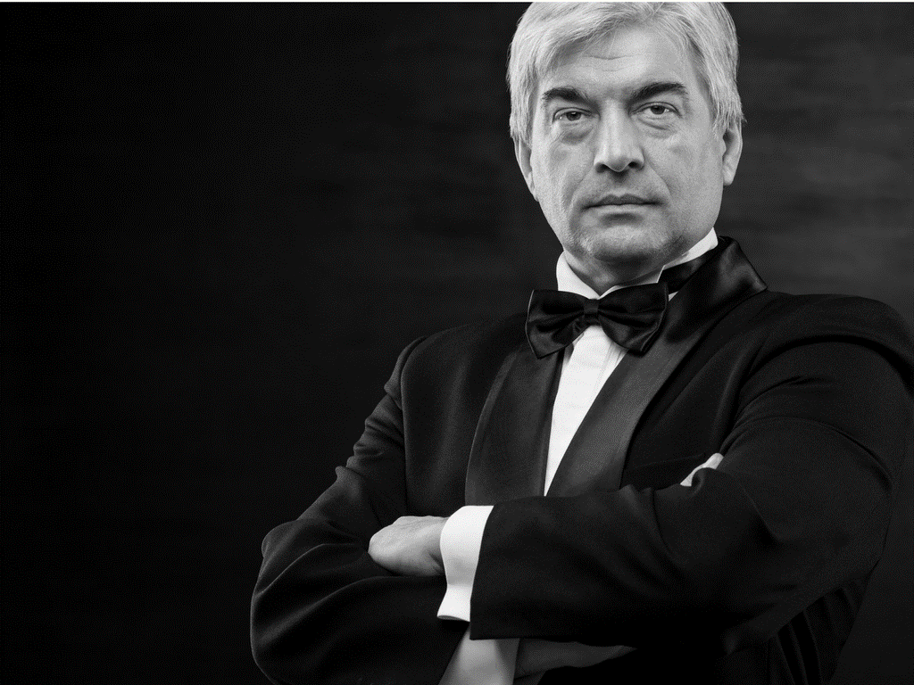
Notes:
Power corrupts Stanford. Intoxicating. We change 3X ipad, interrupt, raise voice
Permission and impact. Biscuits. Seniority. We behave as though seniority is an excuse, not a responsibility.
Bosses, authority, you! Ripples. More impact and frequently worse behaviour
We get there through asking then we end up telling.
Biscuits/ zebra crossing experiments
If we raise the level of arousal in the room we need to know the impact that is having- we can’t just do it because we are the boss.
Zebra crossing/Farah.
Only 4% of people say they are rude because they can get away with it. Many don’t know they were rude.
https://hbr.org/2016/10/dont-let-power-corrupt-you

Slide 74
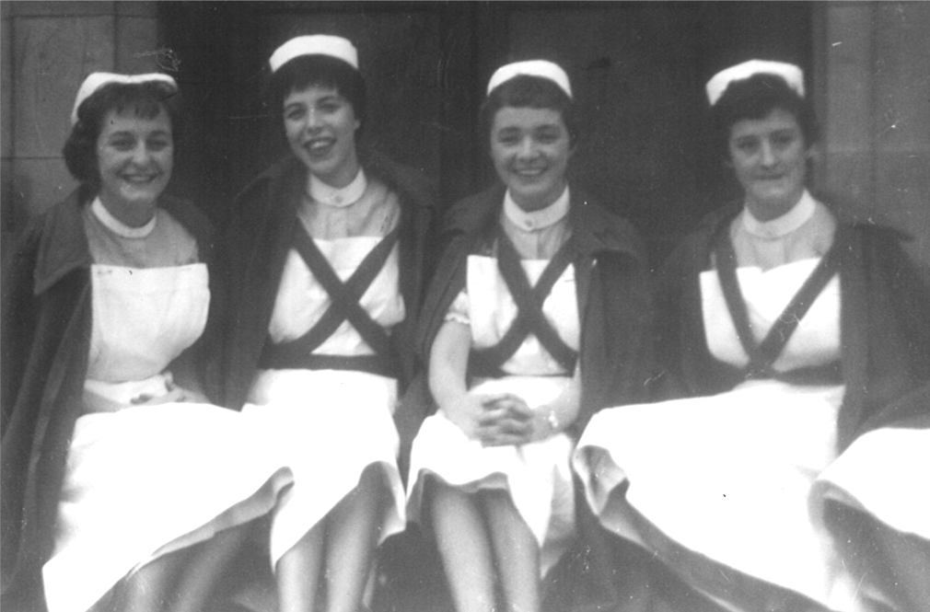
My mum
Notes:
At the Western General Hospital 1959
Wards, cigarettes advised

Slide 75
Notes:
Terrible tll that tobacco takes on health- and we changed
Now it is 201… and we are beginning to understand the impact of behaviour on team outcomes

Slide 76

what a wonderful opportunity….
Notes:
Because we have a brilliant opportunity to do more good for our patients whilst making the workplace better for the vast majority of us and to help our teams (and ourselves) perform at our very best.
I hope I’ve made my point- because if I have then we have a brilliant opportunity to do more good for our patients whilst making the workplace better for the vast majority of us

Slide 77
civility saves lives

Slide 78
Session 5
An Interdisciplinary Approach to Addressing Bullying
The NI Simulation Group

Slide 79
Panel Discussion
Professor Mike Griffin
Dr Edward Morris
Garrett Martin, RCN Northern Ireland

Slide 80
Session 6
Bullying & Harassment in the NHS - Lessons Learnt From NHS Highland
John Sturrock QC
Founder, Core Solutions

Slide 81
Session 7
The Anti-Bullying Alliance
Ms Alice Hartley
Chair, #letsremoveit

Slide 82
Panel Discussion
Professor Mike Griffin
Dr Edward Morris
Garrett Martin, RCN Northern Ireland

